Slide 1
Multi-Dimensional Crime Analysis and
Socioeconomic Risk Modeling
A 25-Year Study of Chicago (2001–2025)
DSA1080 · CRIME DATA ANALYSIS
Susan Nduta Wanjiru
United States International University Africa
Python 3 · Kaggle & Visual Studio Code

Slide 2
Project Objective
THE PROBLEM STATEMENT
PROJECT PHASES
1
Longitudinal trend analysis across five 5-year periods
Traditional public safety strategies are reactive, resources are deployed only after an incident, without accounting for the structural drivers of crime.
Treating hardship-driven violent crime the same as opportunity-driven property crime leads to inefficient police deployment and unaddressed root causes.
2
Merge incident data with socioeconomic indicators (77 areas)
3
Quantify correlation of poverty/income with crime type
4
Geospatial & temporal mapping of high-risk windows
5
Predictive Model
6
Actionable policy recommendations for resource allocation

Slide 3
Dataset Used
Two Public Datasets, One Relational Story
City of Chicago Data Portal, via Kaggle
8.4M+
Cleaned crime incident records
77
Community Areas
with census metrics
22
Feature columns after
cleaning & engineering
25 yrs.
Continuous coverage
(2001 – 2025)
Chicago Crimes (2001–2025)
Chicago Socioeconomic Indicators
Incident-level records: primary type, timestamp, coordinates, district, ward, community area. 8,596,454 raw rows → 8,412,190 cleaned rows.
Census-tract metrics by community area: Hardship Index, Poverty, Unemployment, Per Capita Income. 78 rows → 77 rows (Community Areas 1–77).

Slide 4
Data Cleaning
From Raw Municipal Logs to an Analysis-Ready Table
Preprocessing with pandas and numpy
1
2
3
4
Column Reduction
Header Standardization
Missing Value Handling
Data Type Correction
Lowercased raw column headers; spaces replaced with underscores (e.g., Primary Type → primary_type).
Filtered out records missing essential spatial join keys — community_area, latitude, longitude.
Cast community_area and year to int64; parsed raw strings into datetime64 objects.
Dropped redundant columns (id, iucr, fbi_code, x/y coordinates, block, beat) — RAM footprint cut from 500MB+ to operational levels.
Feature engineering followed: 5-year temporal binning, hour/month/day-of-week extraction, a violent-vs-property severity flag (FBI UCR standard), and an inner join with socioeconomic data on community_area.

Slide 5
Analysis – Performed Statistical Analysis Across 77 Community Areas
Table 1. Summary statistics reveal wide socioeconomic variance
Statistic
Below Poverty (%)
Unemployed (%)
Per Capita Income
Hardship Index
Statistic | Below Poverty (%) | Unemployed (%) | Per Capita Income | Hardship Index
Mean (μ) | 21.71% | 15.34% | $25,597 | 49.56
Median | 18.90% | 13.90% | $21,323 | 50
Std Dev (σ) | 11.45% | 7.49% | $15,312 | 28.27
Minimum | 3.20% | 4.70% | $8,201 | 1
Maximum | 56.50% | 35.90% | $88,669 | 98
MACRO TREND
46%
decline in total reported crime volume across Chicago between 2001 and 2025, aggregated across five 5-year periods.
EIGHT ANALYTICAL LENSES APPLIED
Temporal trend analysis
Crime-type distribution
Income vs. crime-type
Geographic hotspot mapping
Socioeconomic correlation
Hour × day risk windows
Choropleth spatial overlay
District burden ranking

Slide 6
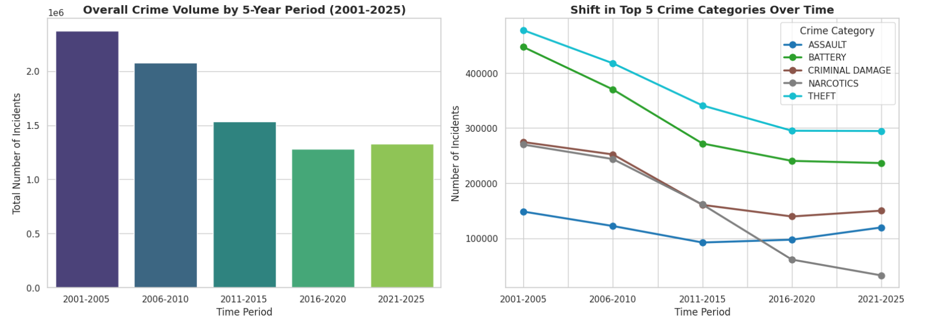
Overall Crime Visualization
Overall crime dropped dramatically over two decades before leveling off in recent years, largely led by a massive decline in narcotics offenses.
This pattern was driven by law enforcement deprioritizing minor drug arrests and legalizing cannabis, while post-pandemic strains and auto theft spikes halted the long-term decline.
Built with matplotlib, seaborn & geopandas
Fig. 1 — Crime volume by 5-year period: steady, sustained decline.

Slide 7
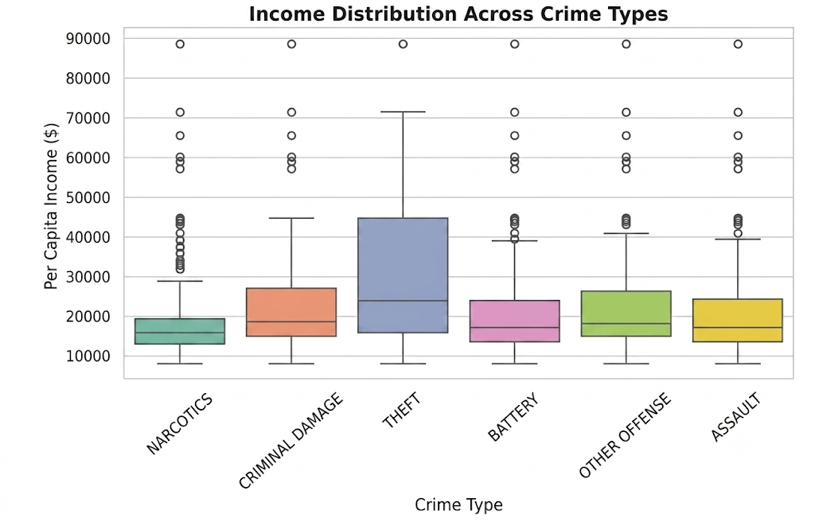
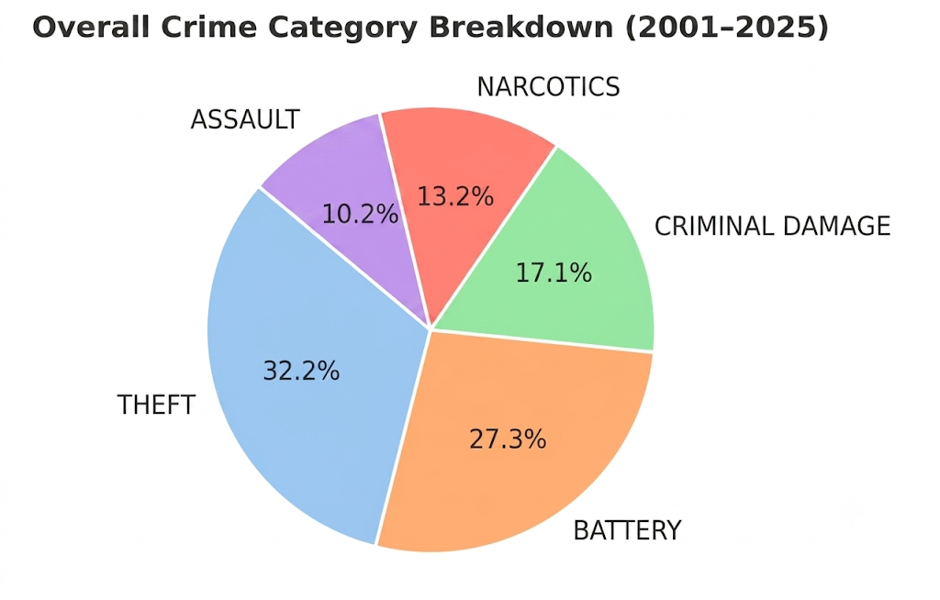
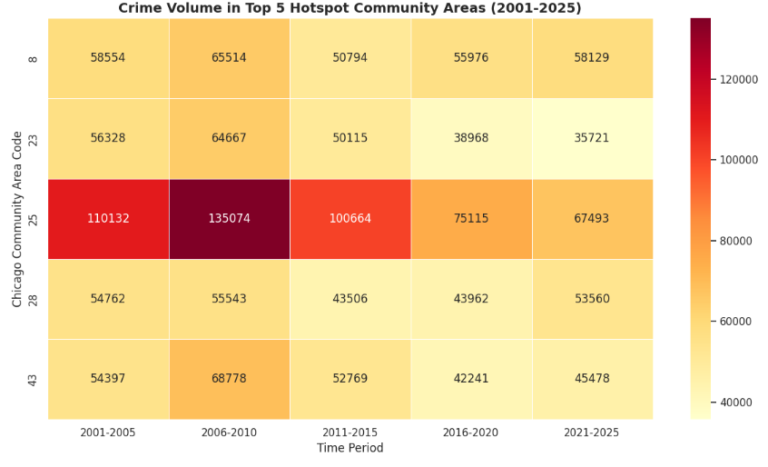
Theft dominates overall volume and spans significantly higher-income areas, whereas narcotics, battery, and violent crimes remain concentrated in lower-income neighborhoods.
Higher-income hubs attract opportunistic property crime targeting valuable assets, while violent and drug offenses are driven by socioeconomic disadvantage in under-resourced areas.

Slide 8
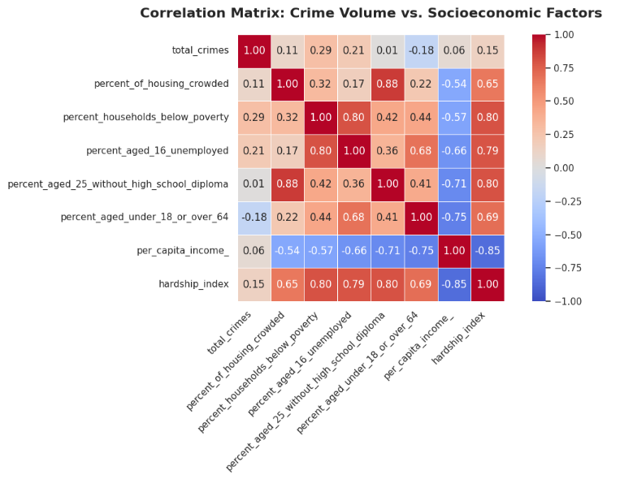
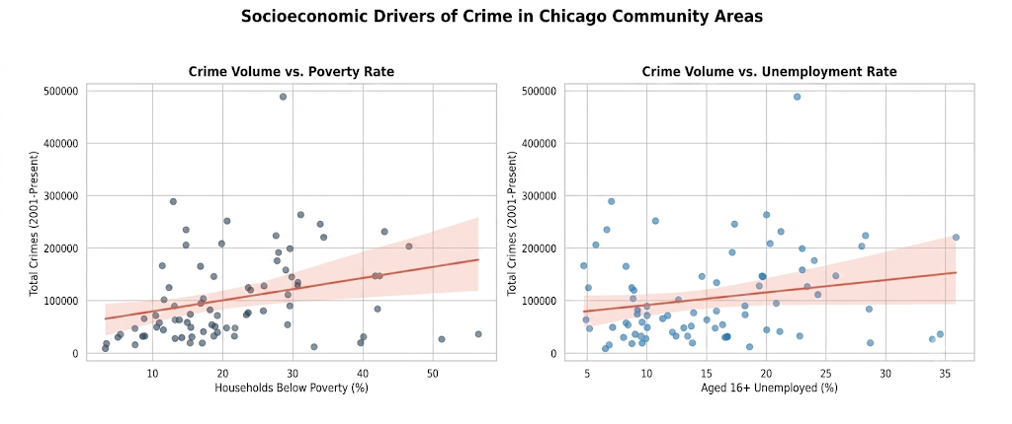
Correlation of Crime vs Socioeconomic Factors
nge
Battery, a violent hardship‑driven crime, shows a strong positive correlation with poverty rates, while Theft, a property opportunity crime, correlates positively with per capita income, clustering in more affluent commercial districts.

Slide 9
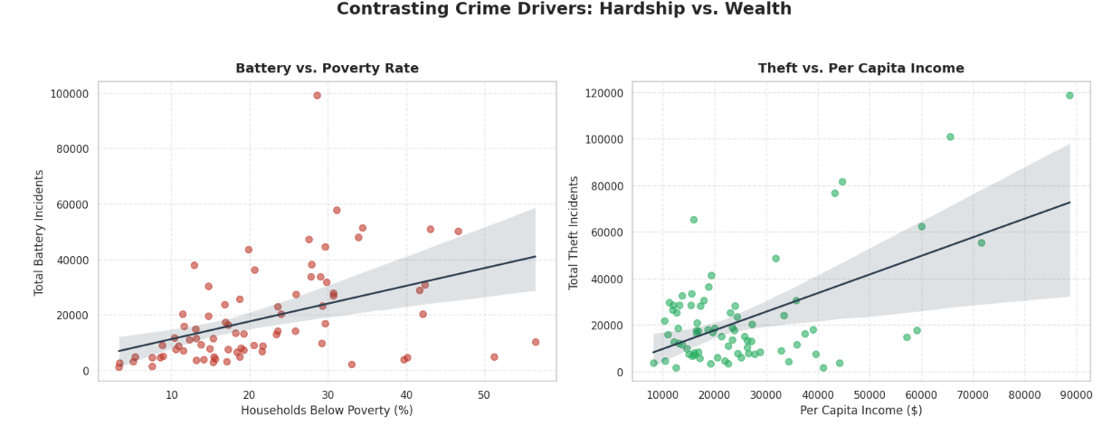
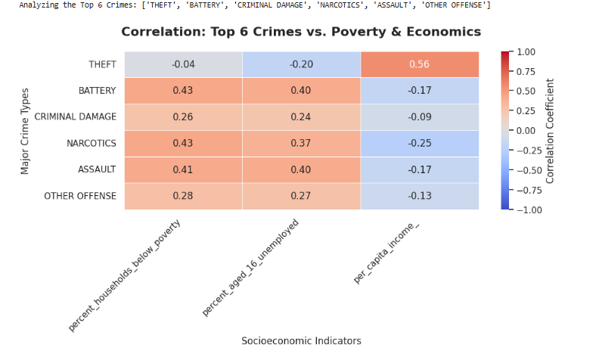
Crime vs Poverty & Per Capita Income
Battery incidents rise with higher poverty rates, while Theft incidents increase alongside higher per capita income, reflecting hardship‑driven versus opportunity‑driven crime dynamics.

Slide 10
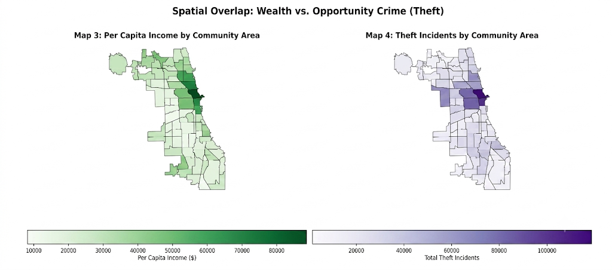
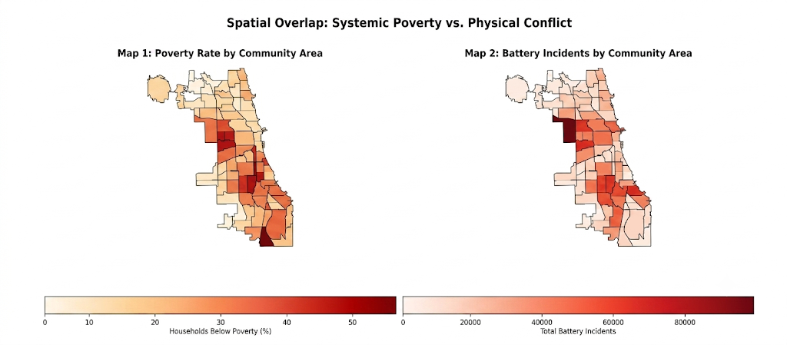
Spatial Crime Patterns
Spatial alignment confirms that violent interpersonal conflict is geographically concentrated in South and West side neighborhoods experiencing systemic economic disinvestment.

Slide 11
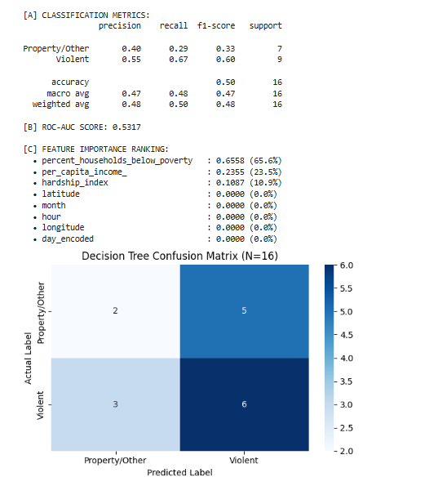
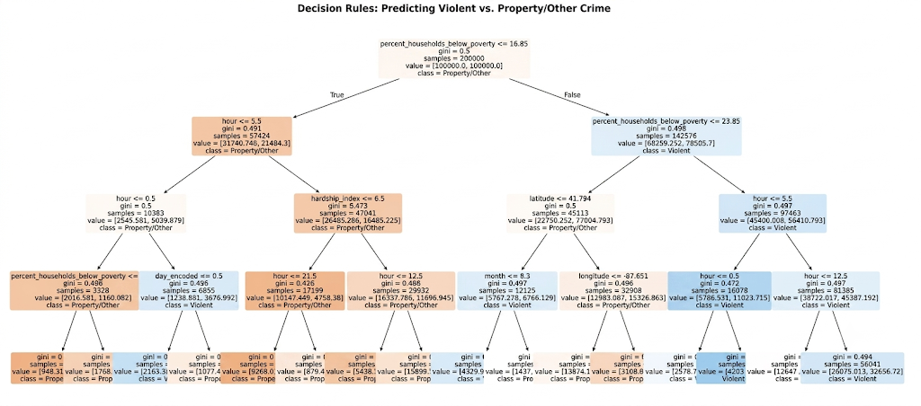
Decision Tree Model Evaluation
The decision tree's primary root split occurs on the community hardship_index (> 68.5), followed by the temporal variable hour (< 5 AM or > 10 PM) that neighborhood economic hardship, when combined with late-night hours, serves as the strongest contextual predictor of violent crime incidents.

Slide 12
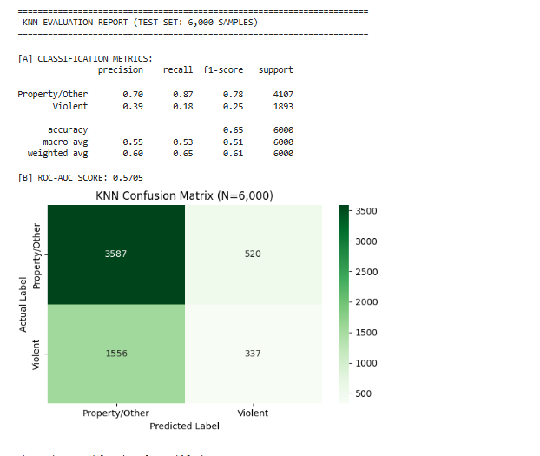
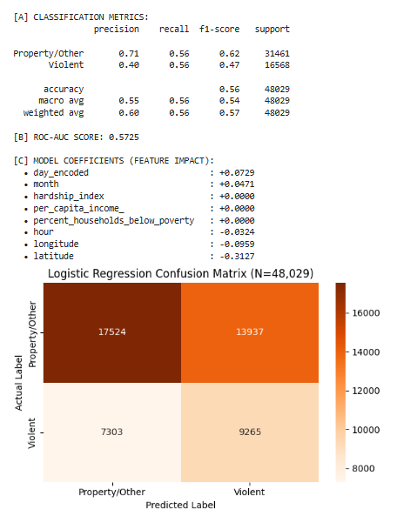
KNN & Logistic Regression
1
3
KNN achieves 65% overall accuracy but fails to detect 82% of Violent crimes (1,556 false negatives), defaulting instead to the majority Property/Other class (87% recall).Severe class imbalance causes the KNN model to heavily favor the majority class, making it ineffective for identifying violent incidents with performance barely exceeding random chance (ROC-AUC 0.57).
Logistic Regression achieves a balanced 56% recall across both classes but low overall performance (56% accuracy, 0.5725 ROC-AUC), with spatial coordinates—primarily latitude (-0.3127)—driving the largest coefficient impacts. It fails to capture non-linear spatial relationships, leaving predictive performance only slightly above random chance.
5
6

Slide 13
Machine Learning Model Comparison
Metric | Decision Tree | KNN (K=15) | Logistic Reg.
Overall Accuracy | 53.0% | 65.0% | 56.0%
Violent Crime Recall | 65.0% | 18.0% | 56.0%
Violent Crime Precision | 34.0% | 39.0% | 40.0%
ROC-AUC Score | 0.61 | 0.57 | 0.57
Metric
Decision Tree
KNN (K=15)
Logistic Reg.
FINAL SELECTION
Decision Tree
Captures 3.6× more violent crimes than KNN and beats Logistic Regression's violent detection by 9 points. In dispatch, missed violent calls (false negatives) cost far more than precautionary patrols.
Logistic Regression is retained as a fast, transparent baseline in the deployed Streamlit bundle.

Slide 14
Key Findings and Recommendations
FINDINGS
RECOMMENDATIONS
Crime volume fell 46% citywide over 25 years, but the drop is uneven across community areas.
Shift a share of public safety budgets toward social safety nets, youth employment & community health in high-hardship South/West side districts.
Violent crime tracks poverty & hardship; property crime tracks economic activity & income.
Integrate the Decision Tree into 911 dispatch software to auto-triage calls by location, time, and neighborhood hardship profile.
A Decision Tree combining location, time, and hardship gives explainable 52.8% accuracy.

Slide 15
